Slide 1

Economic and Investment Outlook July 8, 2025
Equity Market Update
After a difficult first quarter, U.S. equity indexes roared back in the second quarter of 2025, and with the exception of the S&P 600 Small-Cap Index, are now positive for the year. It is fair to say that the snap back caught many investors by surprise as tariff and inflation uncertainty remain. The strength in equities suggests that investors believe the ultimate impact from tariffs will be manageable. Also, economic reports have generally been good, and first quarter corporate earnings were generally solid. However, we continue to expect volatility to remain high over the coming months as we begin to receive more clarity on the final tariff levels that are implemented and whether that negatively impacts inflation.
International equities have fared even better and are up double-digits. About half of the MSCI EAFE International index return has come from currency as foreign returns are converted into weaker U.S. dollars. While forecasting currency moves over the years has been an exercise fraught with peril, we would expect international returns going forward will not get the level of benefit that they have received from a weak U.S. dollar thus far in 2025.
Total Return Performance for the Major U.S. and International Stock Market Indexes
Equity Index | YTD June 30, 2025
United States
Dow Jones Industrial Avg.: 30 Stock Composite | 4.55 %
S&P 500 Composite: U.S. Large Cap | 6.20 %
NASDAQ Composite: Technology Heavy | 5.86 %
S&P 600 Small Cap: U.S. Small Cap | -4.48%
International
MSCI EAFE Large Cap: Europe, Asia & Far East Large Cap | 19.94 %
MSCI EAFE Small Cap: Europe, Asia & Far East Small Cap | 21.24%
MSCI EM Emerging Market: Emerging Market Countries | 15.52 %
Source: Bloomberg, L.P.
www.vestorcapital.com

Slide 2
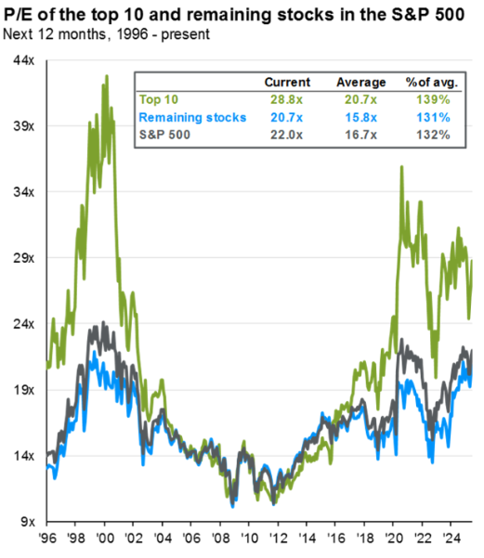
U.S. Equity Valuation Thoughts
A number of market commentators have been warning of high equity valuation levels of U.S. large-cap stocks. The graph below highlights that outside of the ten largest stocks, valuation levels of the remaining 490 stocks in the S&P 500 are not excessive relative to the general market. Most of the ten largest companies have higher revenue and earnings growth rates, margins and financial strength than the typical company, validating their valuations.
Valuation levels have risen since the market bottomed many years ago as the graph below illustrates. However, valuation has historically been a very poor market timing tool. Selling at “the top” and buying back at “cheaper levels” is littered with pitfalls. Staying invested and adding on market weakness has proven to be a sound long-term strategy.
Source: JPMorgan Guide to the Markets 6/30/2025
Tariff Update
Every waking hour we are receiving an update on the tariff front and things can change in the blink of an eye. For this reason, we are hesitant to provide detailed comments due to the fluid nature of tariff negotiations. We believe that the final tariff rates negotiated will not have a significant negative impact on our economy. This is not to say that there will not be some negative impacts, just simply that, in aggregate, our dynamic and diverse economy which is still heavily service based will be able to adjust to whatever the final tariff levels turn out to be. Market strength over the past two months seems to suggest the same message.
www.vestorcapital.com

Slide 3
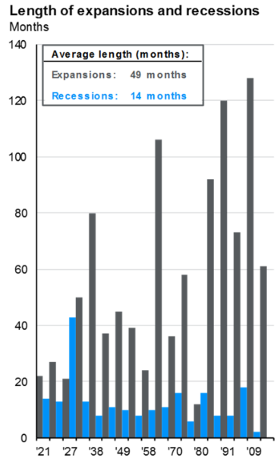
Economy
The bar chart below highlights how our economy has changed over the past 40 years. Expansions have lasted much longer illustrating that our economy is much less volatile due to better inventory tracking and growth in services vs. goods. We believe that this improved consistency does support higher equity valuations. We view the U.S. economy as a giant tanker on the water that takes a long while to turn as opposed to a speed boat that can turn on a dime. This is not to suggest that the business cycle is dead, just that recessions are an infrequent interruption to long-term growth. We speculate that with the aging of America and shortage of workers due to low birth rates, the business cycle may elongate even more in future years.
Source: JPMorgan Guide to the Markets 6/30/2025
Inflation, Interest Rates & Fixed Income
Inflation levels have not accelerated the past few months despite higher tariffs. Of course, tariff levels were paused at 10% for most countries after the initial tariff sticker shock as the president extended the tariff negotiating periods. Final negotiated tariff levels will likely rise to levels above 10%, but below the initially published tariff rates. The impact on inflation is uncertain although we believe that the ultimate cost to the consumer will likely be less than feared.
Due to generally strong economic and employment figures the FOMC under chairman Powell have been hesitant to lower interest rates. We expect this to continue unless employment weakens significantly. The current level of interest rates is higher than inflation indicating that monetary policy is restrictive. Intermediate to long-term interest rates have fluctuated over the past few months, but are generally lower for the year. This has provided a nice backdrop for bond returns. If inflation remains in the 2-3% channel we would expect bond prices to fluctuate, but not move materially. However, if Inflation levels begin to rise, we would expect some pressure on bond prices. Conversely, lower inflation readings would be a positive catalyst for bond prices.
www.vestorcapital.com

Slide 4
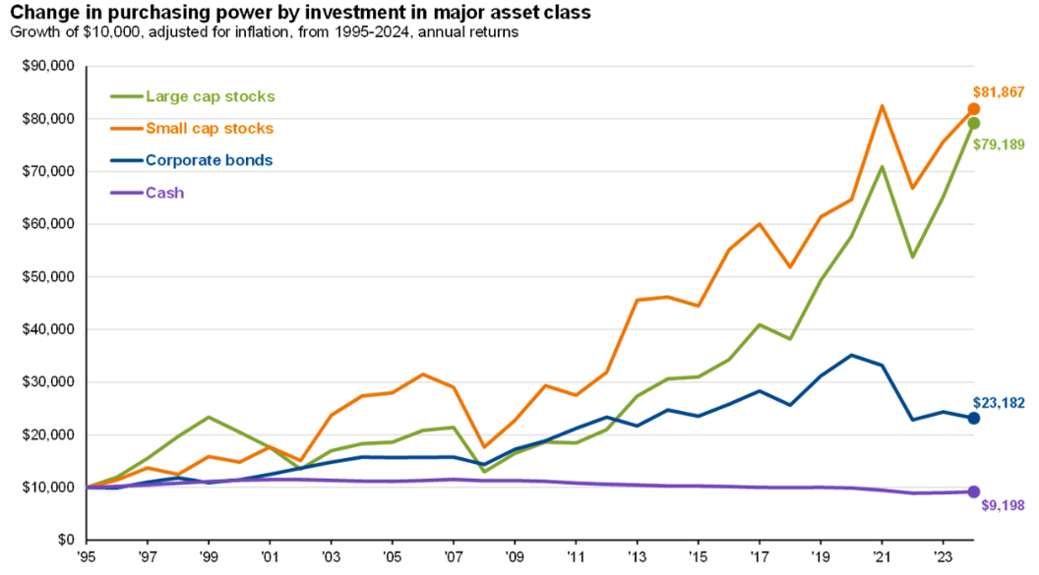
“Big Beautiful Bill”
President Trump recently signed the new budget bill which has something for everyone. While there is a concern over the impact the spending plan may have on our budget deficit, we would note that previous budget bills have similarly added to our growing deficit. While we are not trilled with the limited progress made toward balancing the budget, we are pragmatic in acknowledging that neither political party has the will to make the hard choices and are resigned to this issue continuing. We do not believe that our deficit spending will have a negative impact on equity or bond prices over the short to medium-term as there is growing market apathy toward long-term fiscal issues.
Summary
The chart below highlights that over time, equities have generated attractive long-term returns. As expected, bonds provide lower returns but provide income and portfolio stabilization during times of market stress. Cash has been a drag on purchasing power and has not covered inflation. Alternative asset classes such as infrastructure, private credit and equity are just a few of the class better known as “alternative investments” which are now being made more accessible to individual investors and provide a nice compliment to a traditional stock and bond portfolio. The number of investment choices continues to expand and be made available providing additional diversification options. Despite all the worries that accompany investing, long-term financial success requires patience and discipline to navigate all the curveballs thrown at investors. Enjoy your summer and let us navigate the markets. Thanks for your trust in us!
Source: JPMorgan Guide to the Markets 6/30/2025
This article contains general information and should not be construed as an offer, solicitation, or recommendation with respect to any transaction. Readers of this document are not to view its content as creating an advisory relationship or as providing investment advice, legal advice or tax advice.
Forward-looking statements and assumptions are Vestor Capital’s current estimates or expectations of future events or future results. There is no guarantee that the views and opinions expressed in this article will come to pass, and inherent risks and uncertainties in the market and current conditions could cause actual events and results to differ materially from our predictions and expectations.
Investing involves risk and is not suitable for everyone. Past performance does not guarantee future returns. Actual results could differ materially from the results indicated by this information.
Vestor Capital LLC (“Vestor Capital”) is an SEC registered investment adviser with its principal place of business in the State of Illinois. For more information, including fees and services, email vestor@vestorcapital.com to request our Form ADV brochure and Client Relationship Summary.
10 S. Riverside Plaza, Suite 1400 ∙ Chicago, IL 60606 ∙ T: 312.641.2400 ∙ F: 312.641.3646

